Slide 1
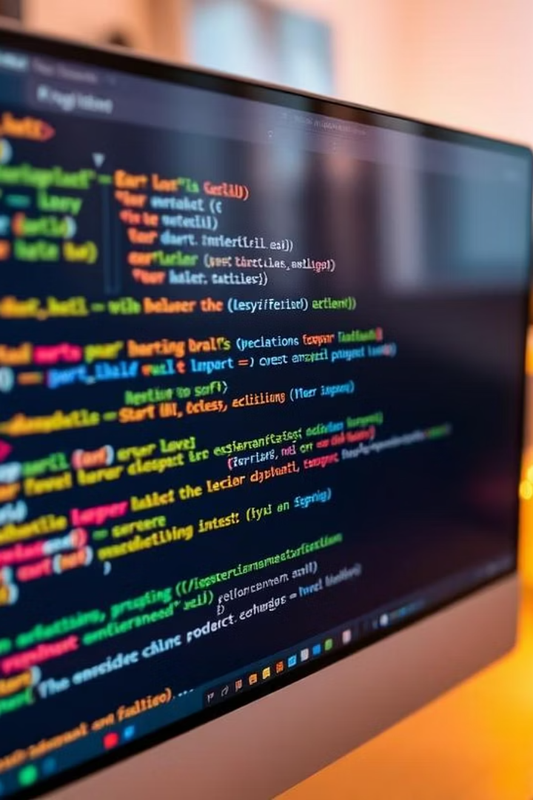


Python Programming Concepts and Examples
This document provides an overview of fundamental Python programming concepts, including data types, variables, loops, functions, object-oriented programming, and advanced features like lambda functions and polymorphism. Each section explains key ideas with code snippets and examples to illustrate practical usage. The document is structured into eight detailed cards for comprehensive learning.

Slide 2

Python Basic Concepts
This section introduces Python fundamentals to build a strong programming base.
We cover variables, data types, and basic input/output operations.
Variables and Data Types
Input and Output
Basic Syntax
Understand how to read user input and display results effectively.
Get introduced to Python's simple and readable coding style.
Learn how to store and manipulate different types of data in Python.

Slide 3
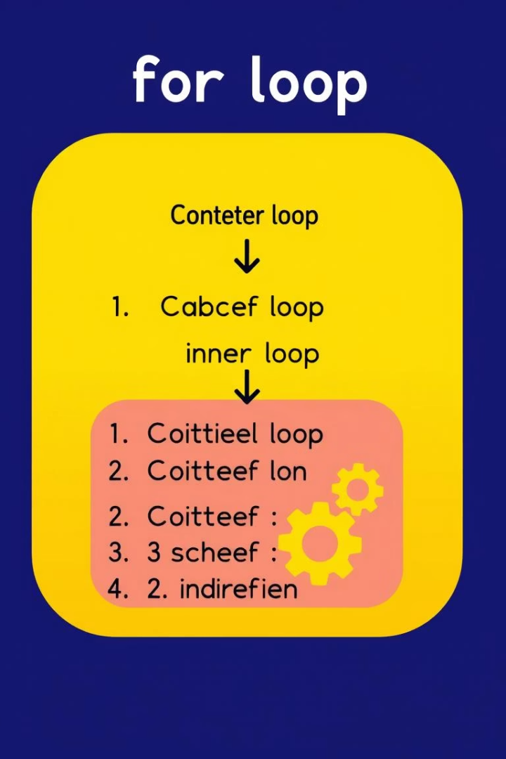




For Loops and Nested Loops
What is a For Loop?
The for loop in Python iterates over a sequence or range of numbers. It is commonly used for counting, processing lists, or repeating actions a fixed number of times.
Nested Loops Explained
Nested loops allow looping inside another loop, useful for multi-dimensional data or patterns.
Example: Iterating over a range of numbers to calculate population changes or print patterns. Nested loops can generate complex outputs like multiplication tables or graphical patterns.
Loops are essential for automating repetitive tasks and managing data collections efficiently.

Slide 4




Control Statements: Break, Continue, and String Operations
String Manipulation
String operations include indexing, slicing, searching, and replacing substrings. For example, reversing a string or finding substrings can be done with built-in methods like find(), isdigit(), and replace().
2
Loop Control
Python provides control statements like break to exit loops prematurely and continue to skip the current iteration. These are useful for managing loop flow based on conditions.
1
Effectiveness
3
These tools help manipulate data and control program logic effectively.

Slide 5

Functions and Lambda Expressions
Functions
Lambda Expressions
Functions encapsulate reusable code blocks. Python functions can take arguments, return values, and support default parameters.
Lambda functions provide concise anonymous functions, often used with map(), filter(), and reduce() for functional programming.
Example: A function to check if a number is even or odd using a lambda expression. Higher-order functions allow passing functions as arguments for flexible code.
Understanding functions and lambdas enhances code modularity and expressiveness.

Slide 6
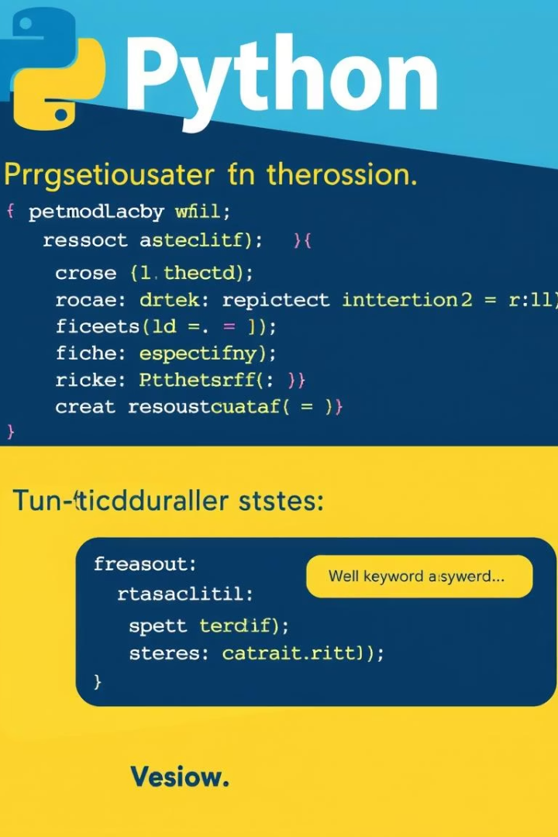
Keyword Arguments and Variable Scope
Python functions support keyword arguments (kwargs) allowing flexible parameter passing by name. This improves readability and function versatility.
Variable scope defines where variables are accessible. Local variables exist within functions, while global variables are accessible throughout the program. Proper scope management prevents naming conflicts and bugs.
Example: Using kwargs to display key-value pairs and understanding local vs global variables in function contexts.

Slide 7

Object-Oriented Programming: Classes and Encapsulation
Python supports object-oriented programming (OOP) with classes and objects. Classes define blueprints for objects, encapsulating data (attributes) and behavior (methods).
Encapsulation hides internal state using private variables and provides public methods for controlled access, improving code maintainability and security.
Example: A Person class with private attributes and getter/setter methods to manage balance demonstrates encapsulation principles.

Slide 8
Inheritance, Polymorphism, and Operator Overloading
Inheritance allows creating new classes based on existing ones, promoting code reuse. Child classes inherit attributes and methods from parent classes, enabling hierarchical relationships.
Polymorphism allows methods to behave differently based on the object context, supporting method overriding and overloading.
Operator overloading lets classes define custom behavior for operators like + or *. While Python supports this, some languages like Java have different implementations.
Example: Defining parent and child classes with constructors, using super() to call parent methods, and demonstrating polymorphic behavior.

